Slide 1
CPSC3300: Computer Systems Organization
Lecture 1 – Introduction

Slide 2
Outline
What is this course about?
Why is this course important?
What should you expect for this course?

Slide 3
The Computer Revolution
Progress in computer technology
Underpinned by Moore’s Law
Makes novel applications feasible
Computers in automobiles
Cell phones
Human genome project
World Wide Web
Search Engines
Computers are pervasive

Slide 4
Classes of Computers
Personal computers
General purpose, variety of software
Subject to cost/performance tradeoff
Server computers
Network based
High capacity, performance, reliability
Range from small servers to building sized
Supercomputers
High-end scientific and engineering calculations
Highest capability but represent a small fraction of the overall computer market
Embedded computers
Hidden as components of systems
Stringent power/performance/cost constraints

Slide 5
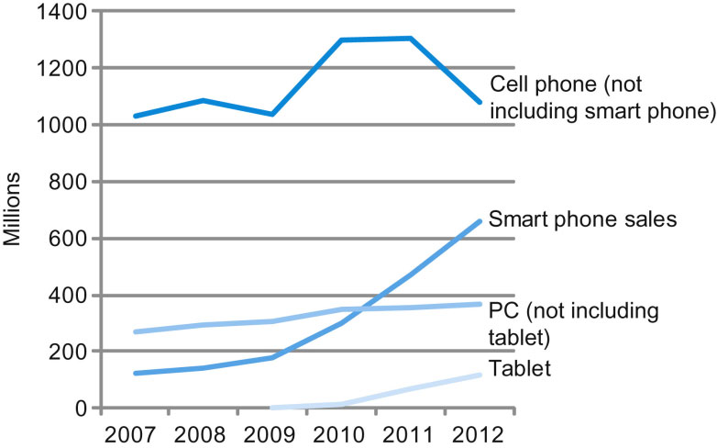
The PostPC Era
FIGURE 1.2 The number manufactured per year of tablets and smart phones, which reflect the PostPC era, versus personal computers and traditional cell phones. Smart phones represent the recent growth in the cell phone industry, and they passed PCs in 2011. Tablets are the fastest growing category, nearly doubling between 2011 and 2012. Recent PCs and traditional cell phone categories are relatively flat or declining.
Copyright © 2014 Elsevier Inc. All rights reserved.

Slide 6
The PostPC Era
Personal Mobile Device (PMD)
Battery operated
Connects to the Internet
Hundreds of dollars
Smart phones, tablets, electronic glasses
Cloud computing
Warehouse Scale Computers (WSC)
Software as a Service (SaaS)
Portion of software run on a PMD and a portion run in the Cloud
Amazon and Google

Slide 7
What You Will Learn
How programs are translated into the machine language
And how the hardware executes them
The hardware/software interface
What determines program performance
And how it can be improved
How hardware designers improve performance
What is parallel processing

Slide 8
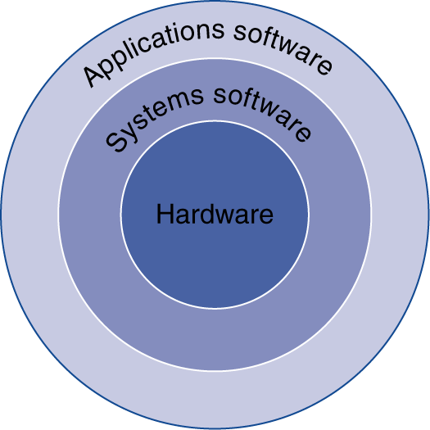
Below Your Program
Application software
Written in high-level language
System software
Compiler: translates HLL code to machine code
Operating System: service code
Handling input/output
Managing memory and storage
Scheduling tasks & sharing resources
Hardware
Processor, memory, I/O controllers
8

Slide 9
Levels of Abstraction for A Computer
Application
Operating
Compiler
System
(Windows 98)
Software
Assembler
Instruction Set
Architecture
Hardware
Processor
Memory
I/O system
Datapath & Control
Digital Design
Circuit Design
transistors

Slide 10
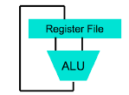

Levels of Representation
temp = v[k];
v[k] = v[k+1];
v[k+1] = temp;
High Level Language Program (e.g., C)
Compiler
lw t0, 0($2)
lw t1, 4($2)
sw t1, 0($2)
sw t0, 4($2)
Assembly Language Program (e.g.,MIPS)
Assembler
0000 1001 1100 0110 1010 1111 0101 1000
1010 1111 0101 1000 0000 1001 1100 0110
1100 0110 1010 1111 0101 1000 0000 1001
0101 1000 0000 1001 1100 0110 1010 1111
Machine Language Program (MIPS)
Machine Interpretation
Hardware Architecture Description (e.g., block diagrams)
Machine Interpretation
Control Signal Specification

Slide 11
A Translation Hierarchy
High Level Language (HLL) programs first compiled (possibly into assembly), then linked and finally loaded into main memory.
C, Fortran, and some other HLL
C
o
m
p
i
l
e
r
A
s
s
e
m
b
l
y
l
a
n
g
u
a
g
e
p
r
o
g
r
a
m
A
s
s
e
m
b
l
e
r
O
b
j
e
c
t
:
M
a
c
h
i
n
e
l
a
n
g
u
a
g
e
m
o
d
u
l
e
O
b
j
e
c
t
:
L
i
b
r
a
r
y
r
o
u
t
i
n
e
(
m
a
c
h
i
n
e
l
a
n
g
u
a
g
e
)
L
i
n
k
e
r
E
x
e
c
u
t
a
b
l
e
:
M
a
c
h
i
n
e
l
a
n
g
u
a
g
e
p
r
o
g
r
a
m
L
o
a
d
e
r
M
e
m
o
r
y

Slide 12
Understanding Performance
Algorithm
Determines number of operations executed
Programming language, compiler, architecture
Determine number of machine instructions executed per operation
Processor and memory system
Determine how fast instructions are executed
I/O system (including OS)
Determines how fast I/O operations are executed

Slide 13
This Course Is Important – for Programming
Machine structures from a programmer's view
What the programmer writes
How it is converted to something the computer understands
How the computer interprets the program
What makes programs go slow
Notes:
We will take a break and talk about class philosophy.

Slide 14








Eight Great Ideas
Design for Moore’s Law
Use abstraction to simplify design
Make the common case fast
Performance via parallelism
Performance via pipelining
Performance via prediction
Hierarchy of memories
Dependability via redundancy

Slide 15
What Should You Expect -- Work
Attend the lectures and be active
Lectures on Mondays and Wednesdays
Do the assignments
Reading textbook and supplementary materials
Homework assignments
Projects
Prepare for two midterm exams and a final exam

Slide 16
What Should You Expect – Grading
Grading
Homework – 15%
Projects – 15%
Zybooks participation activities – 10%
Quizzes – 5%
Attendance – 5%
Midterm exam I – 15%
Midterm exam II – 15%
Final exam – 20%

Slide 17
What Should You Expect -- Policies
Course information on course website and canvas
Assignments and due dates
Lecture notes
Supplementary materials
Late Assignments
No late submission for homework assignments since on some due dates the homework answers will be discussed during class time.
Projects submitted late will receive a 10 point deduction (10 percent) for each day past due.
The Academic honesty code for details
For individual assignments, you should program by yourself and must not share them. Plagiarism will result in a score of zero or negative points, and/or reported to the university.
Debug your code

Slide 18
My Goal as an Instructor
To make your experience in CPSC 3300 as enjoyable & fruitful as possible
Approachability
Fun, challenging projects & HW
To improve promptly
I do listen!
Please give me feedback so I improve!
Help me help you!

